Slide 1
Loyola University Chicago Faculty Council
The role of faculty in shared governance &
the LUC Faculty Handbook
Dr. Tavis Jules, School of Education
Chair, Faculty Council
New Faculty Orientation
Fall 2021

Slide 2
Shared Governance

Slide 3
Shared Governance
According to AAUP’s Statement on Government of Colleges and Universities:
shared governance refers to the responsibility shared among the different components of the institution—governing boards, administrations, and faculties—for its governance, and the specifies areas of primary responsibility for each component.
The role of the faculty is to have primary responsibility for such fundamental areas as curriculum, subject matter and methods of instruction, research, faculty status, and those aspects of student life which relate to the educational process. The responsibility for faculty status includes appointments, reappointments, decisions not to reappoint, promotions, the granting of tenure, and dismissal.
For more information: www.aaup.org/shared-governance

Slide 4
Shared Governance at LUC

Slide 5
Elected LUC Shared Governance Bodies
Faculty Council*
University Senate*
University Staff Council*
Student Government
Graduate, Professional, and Adult Council
Graduate Student Advisory Council
* These three bodies will briefly be covered for the purpose of today’s presentation

Slide 6
Faculty Council
Faculty Council consists of members elected by the various faculties of the University. It represents the faculty to the university administration and may address any matter of importance to the university, in general, and to the faculty in particular.
Faculty Council is advisory to the President and the Senior Academic Officers. Faculty Council also provides input on issues being considered by the University Senate and will, when appropriate, make policy recommendations.
Faculty Council also nominates faculty members for important university committees, such as the Faculty Appeals Committee and URTC among others.
www.LUC.edu/faccouncil/

Slide 7
Oldest Shared Governance Body on Campus, Since 1964 consisting of members elected by the various faculties of the University
LUC’s highest elected faculty body representing more than 2,000 faculty at the Lake Shore Campus, Water Tower Campus, Health Sciences Division, and overseas (Rome) campus
Forty-member body represents the faculty to the university administration and may address any matter of importance to the university in general and to the faculty in particular.
Governed through Bylaws and a Constitution

Slide 8
40 Elected Members
College of Arts and Sciences – Humanities (6 Representatives)
College of Arts and Sciences - Natural Sciences (4 Representatives)
College of Arts and Sciences - Social Sciences (3 Representatives)
Arrupe College (1 Representative)
Quinlan School of Business (3 Representatives)
School of Communication (1 Representative)
School of Education (2 Representatives)
School of Environmental Sustainability (1 Representative)
Parkinson School of Health Sciences and Public Health (1 Representative)
Institutes and School of Continuing and Professional Studies (1 Representative)
School of Law (2 Representatives)
Stritch School of Medicine: Basic Sciences (2 Representatives)
Stritch School of Medicine: Clinical (6 Representatives)
Marcella Niehoff School of Nursing (2 Representatives)
School of Social Work (1 Representative)
University Libraries (2 Representatives
Ex Officio Member University Senate Chair, Provost

Slide 9
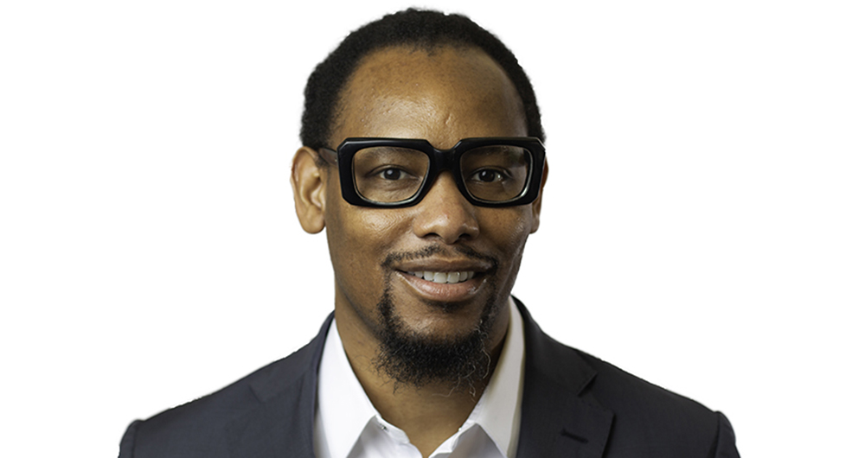
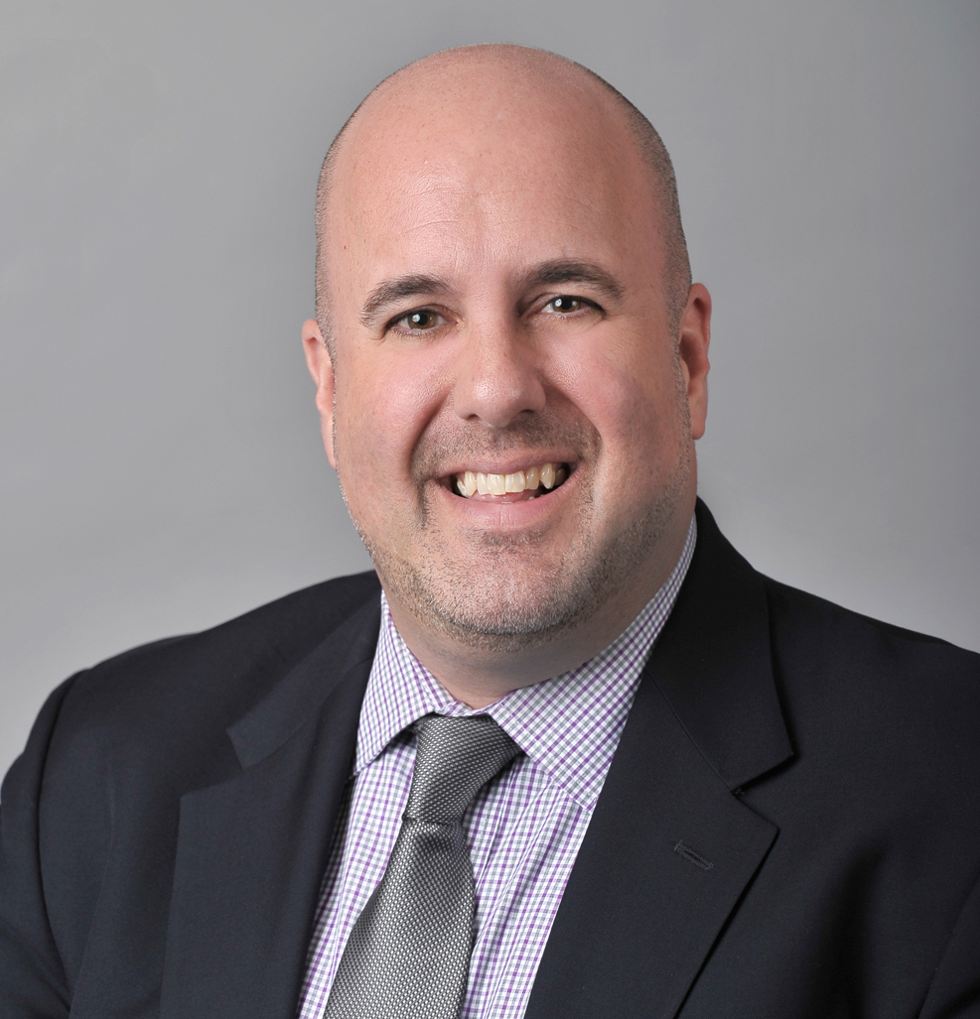
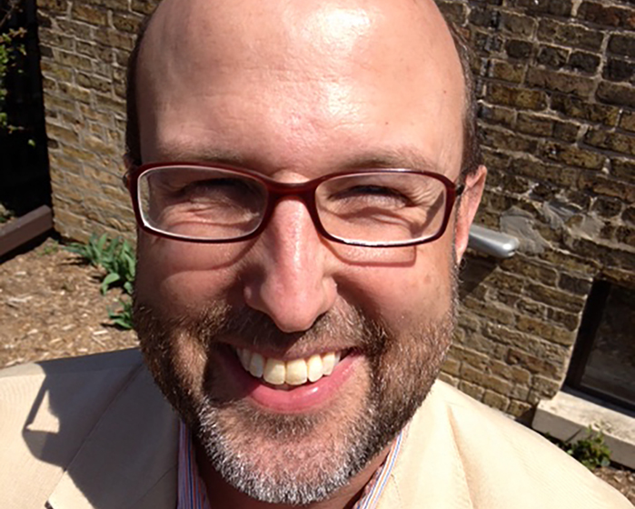
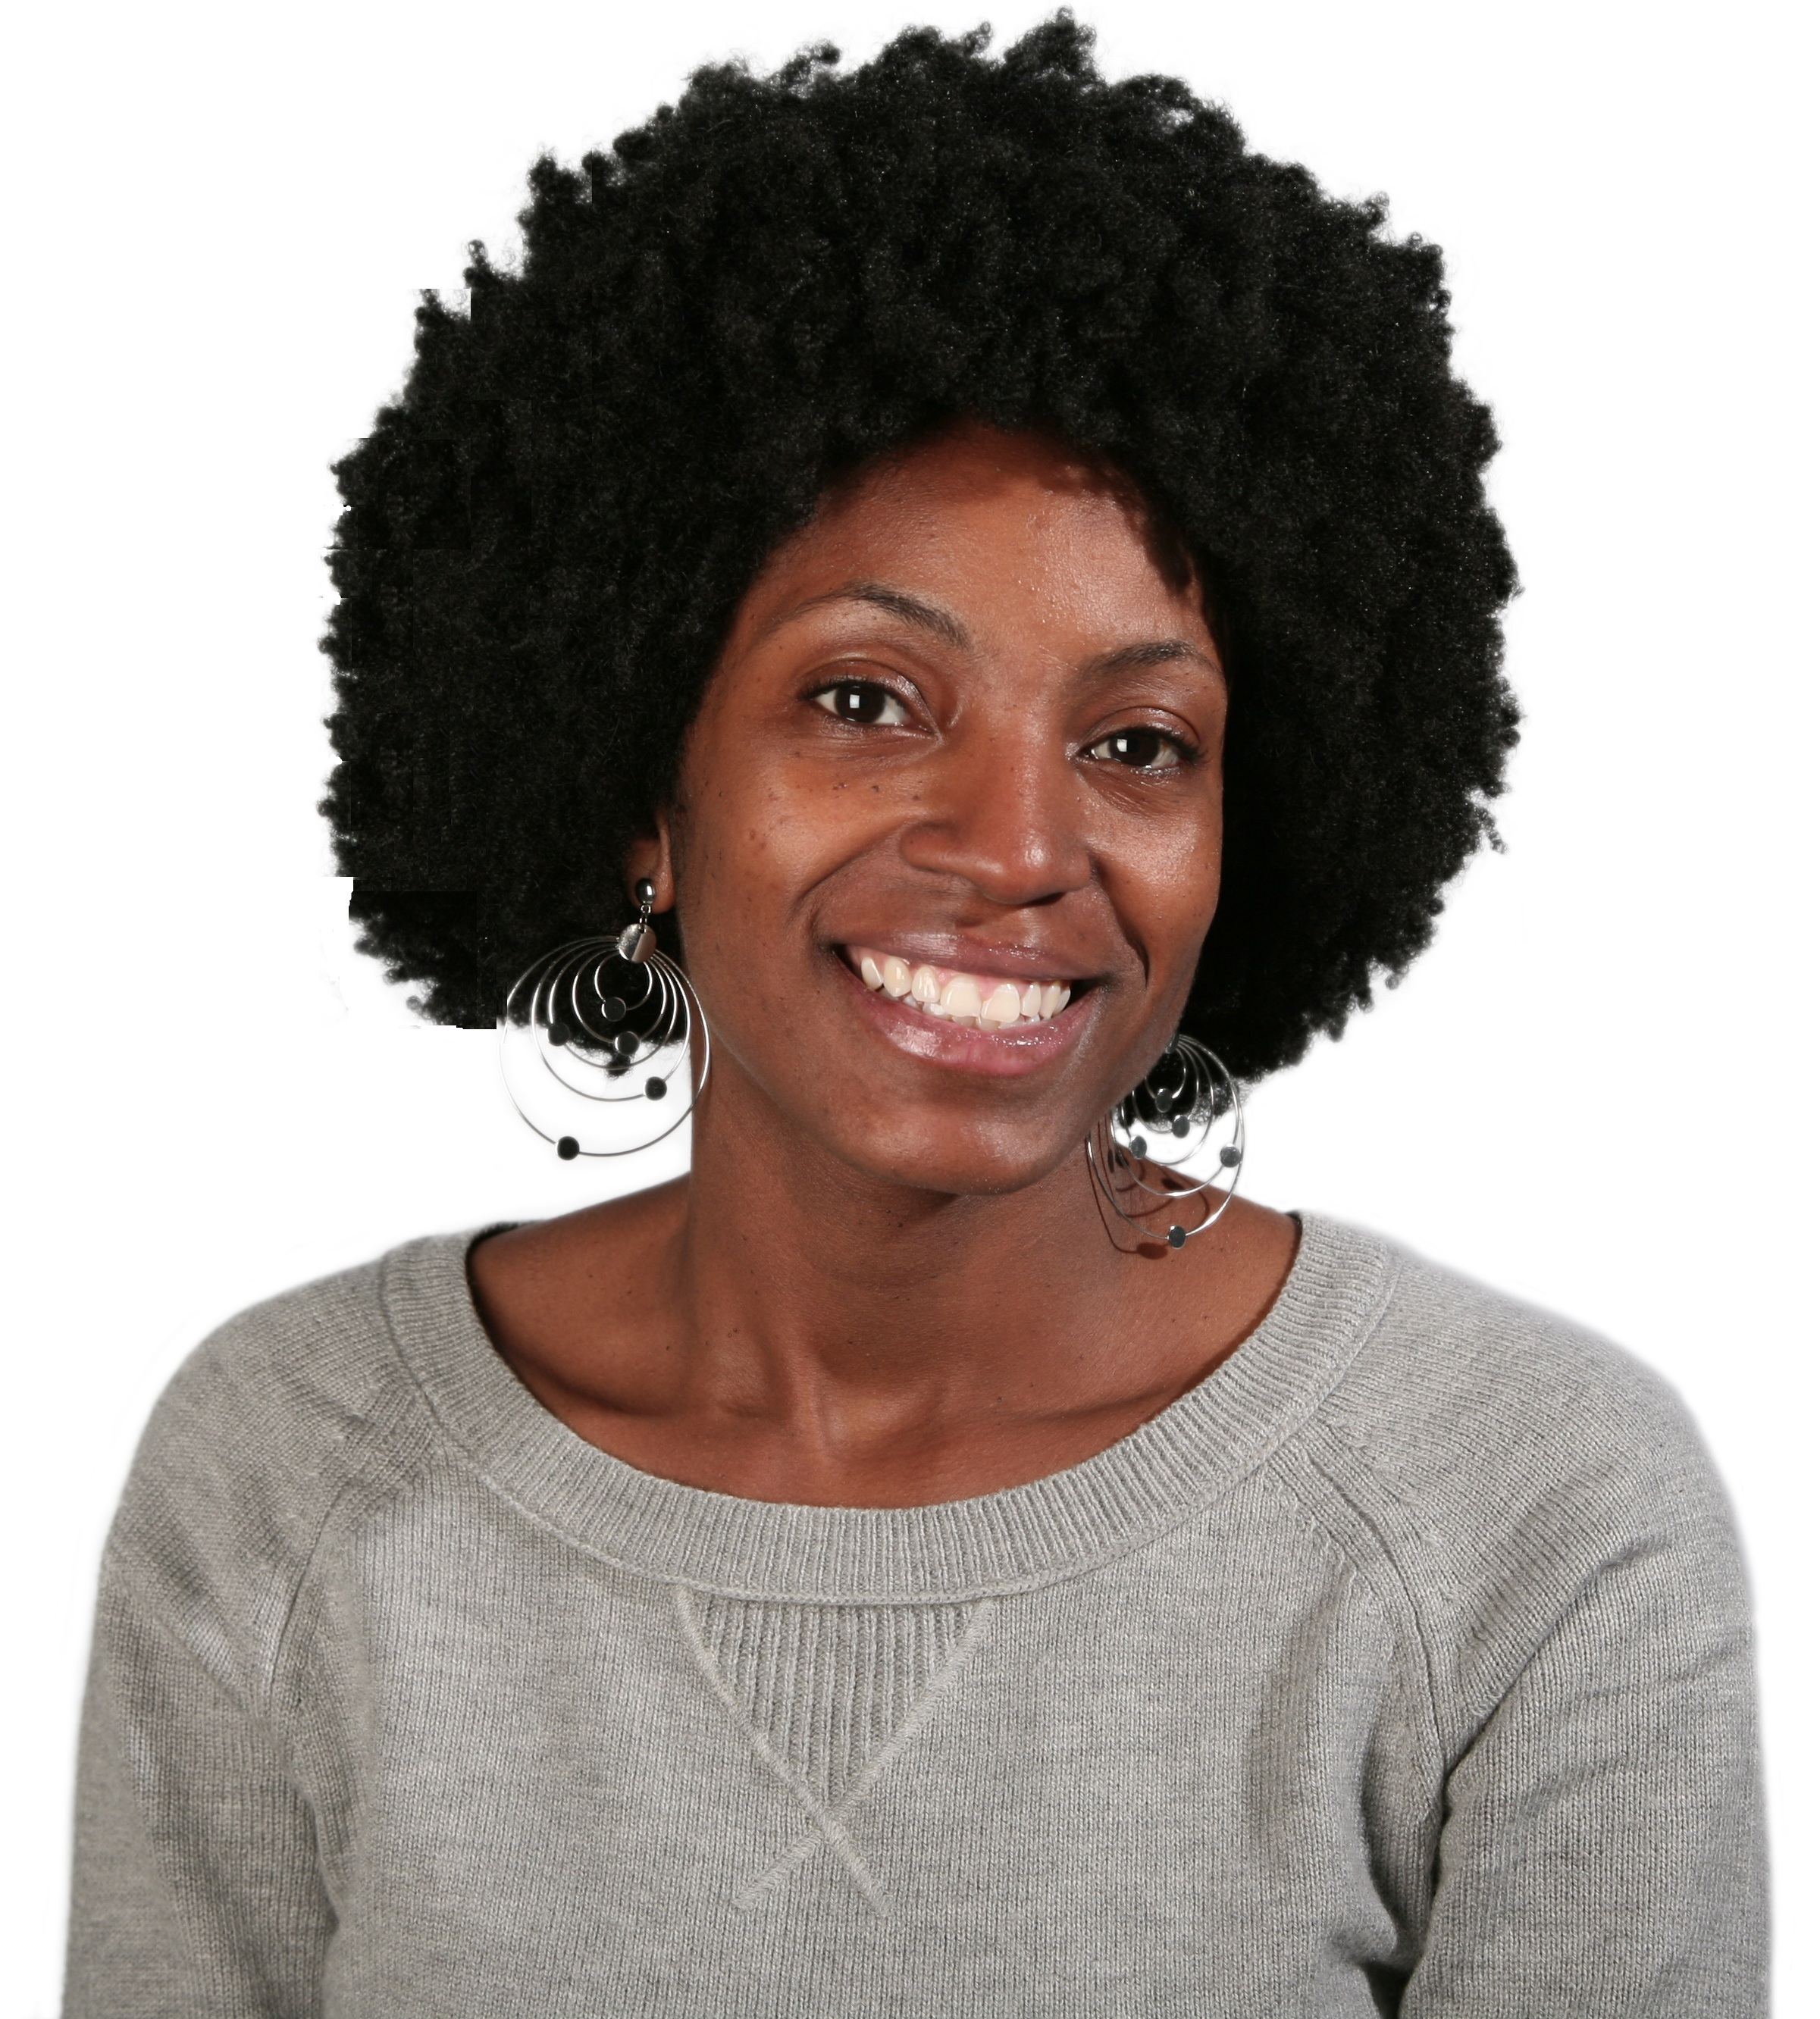
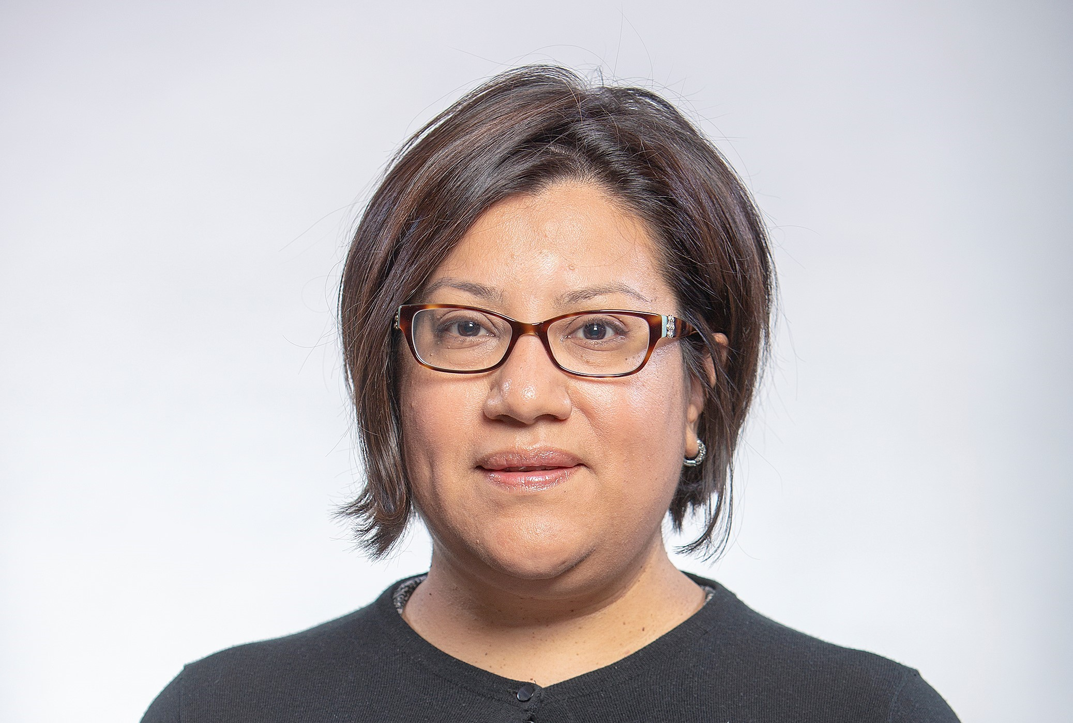
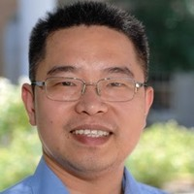
Executive Council

Slide 10
Month | Exec. Cmte. | Faculty Council
August | --- | 25th
September | --- | 29th
October | --- | 27th
November | --- | 17th
January | --- | 26th
February | --- | 23rd
March | --- | 30th
April | --- | 27th

Slide 11
Committees
Faculty Affairs Committee
Responsibilities:
The Faculty Affairs committee is involved in the review and oversight of matters addressed in the Faculty Handbook. This includes, but is not limited to, policies and procedures related to faculty appointments, retention, research support and infrastructure, professional leaves, faculty status (salaries and benefits) faculty workload, and conducting the faculty elections to other university committees. This committee will coordinate with the University Benefits Committee. The committee will conduct an annual review of faculty salaries, and assess programs dealing with faculty leaves, grants, conflicts of interest in research, misconduct in scholarship, intellectual property rights, and compliance with federal regulatory programs for human or animal subject research.
Committee Chair: Peter Rosenblatt, 2020-2022

Slide 12
Committees
Academic Affairs Committee
Responsibilities:
The Academic Affairs Committee of Faculty Council is involved with all aspects of the academic programs at the university, including assessment of teaching, student learning and research and the overall quality of academic programs at the undergraduate and graduate and professional level. Matters within its purview include academic support, library and IT support. This committee should review major proposals that involve restructuring of the academic programs and units, revisions of the core curriculum, substantial changes in the academic calendar, new programs and major revisions to existing programs. The Chair of Faculty Council will contact the President of the University Senate to coordinate all deliberations on academic policy related proposals. Results of the Faculty Council deliberations will be passed on to the University Senate.
Committee Chair: Julia Elsky, 2021-2023

Slide 13
Committees
Faculty Service and Communications Committee
Responsibilities:
The Service and Communications Committee will select the Faculty Member of the Year (meet in summer, award at fall convocation), conduct elections for Faculty Council (February and March) and faculty representation on university committees, conduct the evaluation of academic deans, and author periodic newsletters and other communications to send to LUC faculty.
Committee Chair: Harel Dahari, 2020-2022

Slide 14
Committees
Faculty Handbook Committee (ad hoc under Faculty Affairs)
Responsibilities:
The Faculty Handbook Committee oversees reviews and updates to the LUC Faculty Handbook so that it reflects current and best practices. The LUC Faculty Handbook serves as a contract between Corporate Faculty and the University that outlines key responsibilities, policies, procedures, best practices, and expectations.
Committee Co-Chairs: Ian Cornelius, 2020-2022 Tavis D. Jules, 2021-2023

Slide 15
The LUC Faculty Handbook

Slide 16
Highlights from 2015 LUC Faculty Handbook
Faculty Rights and Responsibilities (p. 34)
It is expected that Loyola faculty will strive for excellence in the areas of teaching, research/scholarship (including artistic accomplishment), professional practice (if applicable) and service.
Specific faculty responsibilities are described in letters of appointment and/or annual contracts and are determined by the departmental chairpersons, academic supervisors, and deans, the general expectations are listed in the handbook and apply to all faculty.

Slide 17
Highlights from 2015 LUC Faculty Handbook
Appeals Processes (p. 59)
In specific instances, a faculty member may have recourse to the Faculty Appeals Procedure.
Matters which may be appealed to the President and which the President shall refer to the Committee are matters which allege one or more of the following:
(a) that the faculty member involved has been unjustly dismissed for cause;
(b) that, in matters involving promotion, tenure, non-reappointment, termination, or salary, there has been discrimination against the faculty member on account of his or her age, sex, race, religion, national origin, sexual orientation, gender identity, non- disqualifying disability, or other characteristic protected by applicable law;
(c) that there has been a significant violation of procedures related to decisions affecting promotion, tenure, non-reappointment, termination, or salary; and/or
(d) that the faculty member’s academic freedom has been violated.

Slide 18
Highlights from 2015 LUC Faculty Handbook
Intellectual Property (p. 39)
Loyola encourages research, scholarly and artistic accomplishments that might lead to patentable inventions or discoveries.
A faculty member must disclose to Loyola all discoveries, inventions or improvements, whether patentable or not, which are conceived or reduced to practice by a faculty member with support from, or use of, Loyola funds, facilities, or other resources.
Ownership of such items is addressed in the Intellectual Property and Technology Transfer Policy which may be found at http://www.LUC. edu/ors/patentpolicyshtml. All faculty members must comply with these policies as applicable.

Slide 19
Highlights from 2015 LUC Faculty Handbook
Conflict of Interest (p. 37)
A potential or actual conflict of interest may exist when a faculty member’s commitments or obligations to Loyola may be compromised by his or her personal or business interests or commitments (especially economic), particularly if those interests or commitments are not disclosed.
Although not all conflicting interests are impermissible, those involving the faculty member’s self-gain or gain by a third party to whom the faculty member is related may serve to compromise the faculty member’s primary obligation to Loyola.
Additional information about the interests and commitments that may constitute conflicts of interest may be found at http://www.LUC.edu/ hr/policies/policy_conflictofinterest.shtml (for the Lakeside Campuses). For the Health Sciences Campus, those policies are available from the Senior Academic Officer.

Slide 20
Update ON Forthcoming LUC Faculty Handbook
A group of faculty comprised of representatives across schools and departments have been working over the past 2 years on an updated LUC faculty handbook.
Plan to submit to the Provost and President by November 2021
Current 2015 LUC faculty handbook may be found here:
https://www.luc.edu/media/lucedu/academicaffairs/pdfs/Faculty-Handbook-LoyolaUniversityChicago_2015.pdf

Slide 21
Ongoing Issues and priorities
Revising the Faculty Handbook
Benefits
Report on the Taskforce on Shared Governace

Slide 22
Short History of Faculty Council
For an additional reference on the history of faculty council, please note that the following presentation was created by Dr. Pamela Caughie (Department of English/CAS) for the LUC Faculty Council Retreat in January 2021.
https://luc.hosted.panopto.com/Panopto/Pages/Viewer.aspx?id=33428e5b-a79c-4d94-b48b-ad1b0164a852

